Slide 1
Business Canvas
Noah Templet, Jared Moise, Michael Sheppard, Brian Simpson

Slide 2
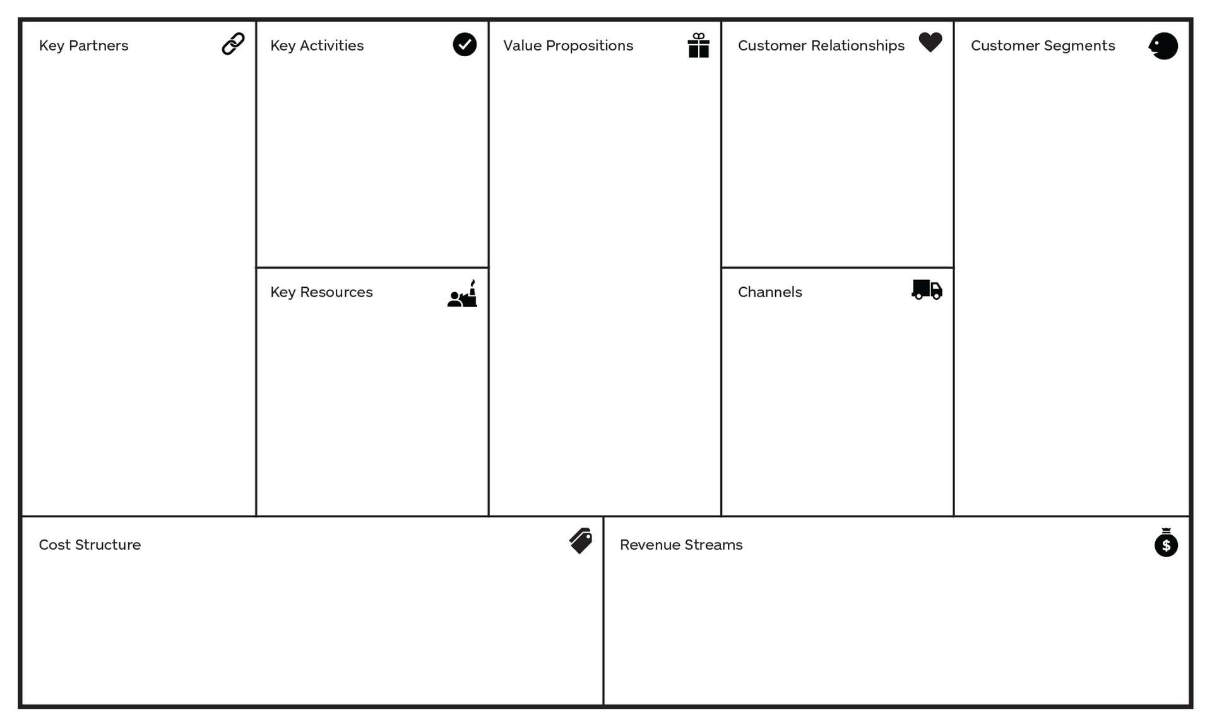
Businesses with specials that provide the information needed for app.
As a part of the agile process, the users of the service will be a key partner in developing further features.
Build large number of active daily users.
Clean easy to use system
- Kill customer pain through eliminating the need to look in multiple places for information.
- Customer gain through lowering costs
- Kill business pain of having to post information in multiple places
- Business gain through free centralized advertising.
Add words
Customers and businesses that offer specials
- Human resources in the sense of programmers.
- Information resources in the sense of specials from businesses
Owned direct channel - the website.
~$100:
~$65 - SSL Certification
~$5 - Domain Registration
~$30 - Storage and Hosting
In-app advertisements along with the ability to buy a pro version to prevent ads. Corporation management tool with yearly subscription fee.

